Slide 1






Foundations of
Quantum Computing
(QIS 301)
Dave Biersach
Brookhaven National Laboratory
dbiersach@bnl.gov
Session 05
Early Quantum Mechanics

Slide 2
Session Goals
Understand how double-slit diffraction enables the measurement of photon wavelengths
Predict the spectral emission lines of the Hydrogen atom using the Rydberg Formula
Discuss the evolution of the early atomic models
Develop the Bohr Atomic Model for Hydrogen
Calculate spectral lines using the Bohr Atomic Model
Compare the Rydberg Formula to the Bohr Model

Slide 3
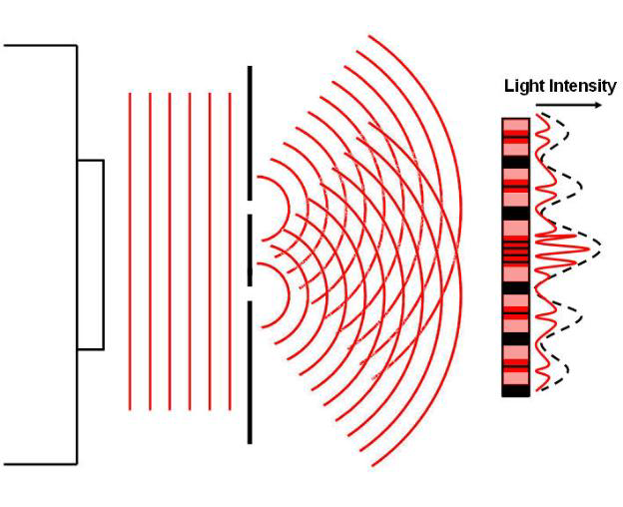
Double Slit Diffraction

Slide 4
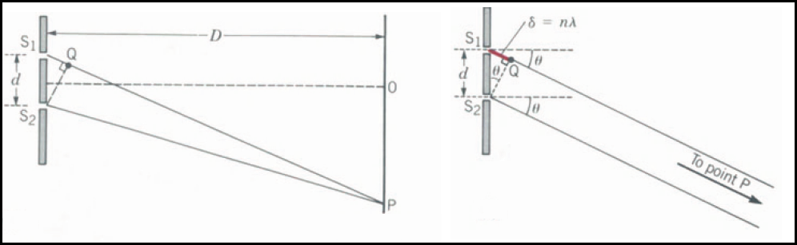


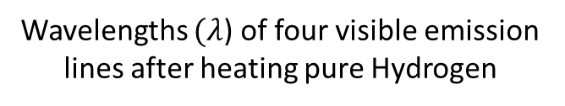
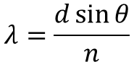
Double Slit Diffraction
For constructive interference:
$$d\sin{θ}=nλ$$
Wavelengths $(λ$) of four visible emission lines after heating pure Hydrogen
$$λ=\frac{d\sin{θ}}{n}$$

Slide 5
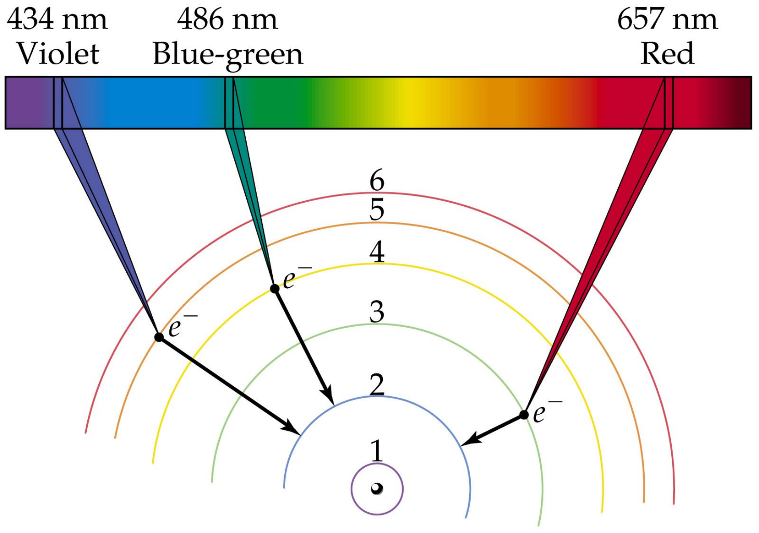
An Inward Electron Transition Emits a Photon

Slide 6
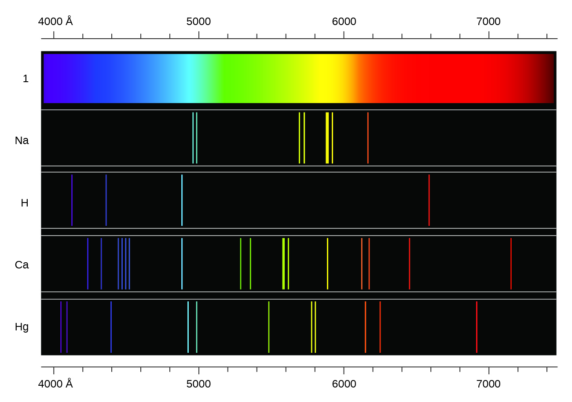
Spectral Emission Lines

Slide 7
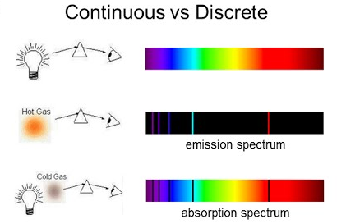
Spectroscopy
Monatomic Gas
Monatomic Gas

Slide 8
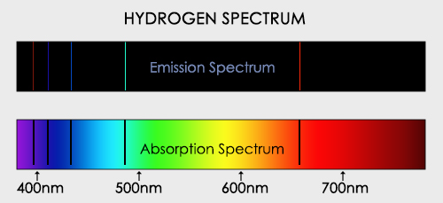
Spectroscopy

Slide 9
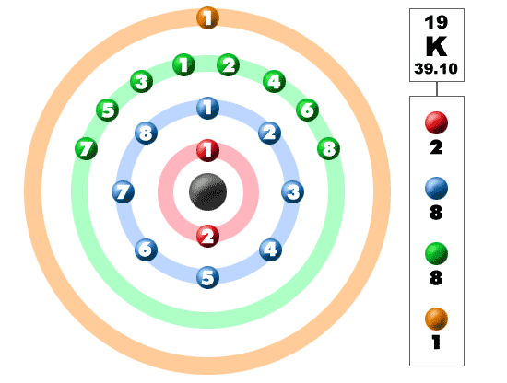
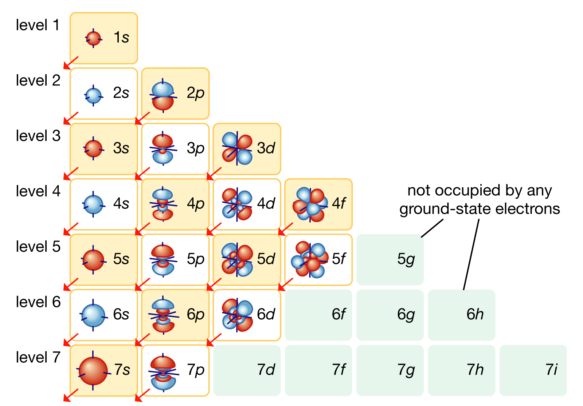
Electron Shells – Periodic Table
Why did we pick the letters s, p, d, f ??

Slide 10
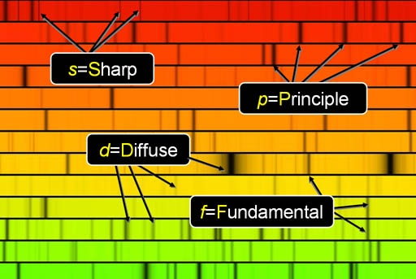

Spectral Absorption Lines
The s, p, d, f
come from the way the absorption spectra lines “look”

Slide 11
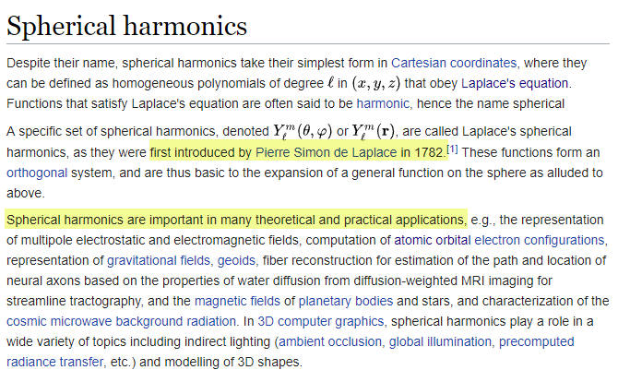
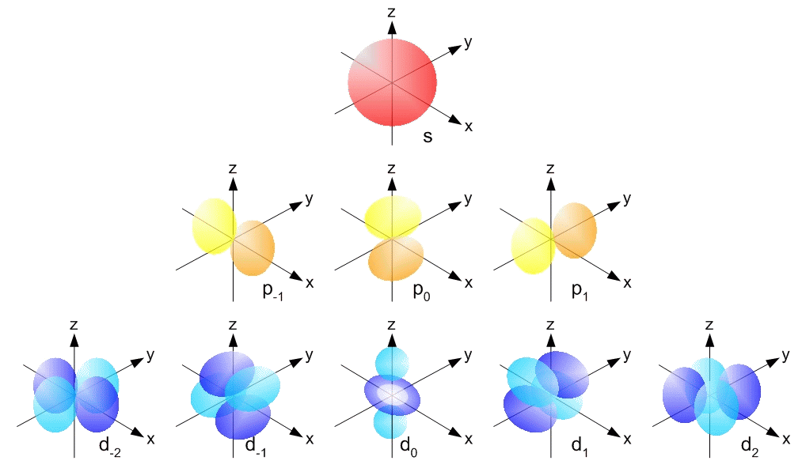
Spectral Emission Lines

Slide 12
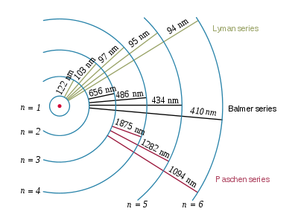
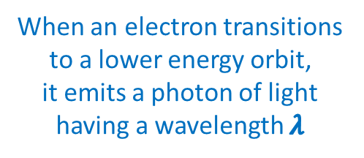
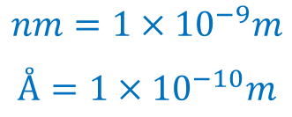
Spectral Emission Lines
Hydrogen Emission Lines
When an electron transitions to a lower energy orbit, it emits a photon of light having a wavelength $λ$
Initial orbit
Final orbit
$$nm=1×{10}^{−9}m$$
$$Å=1×{10}^{−10}m$$

Slide 13
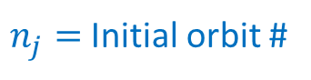
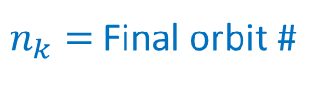
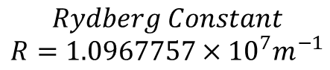
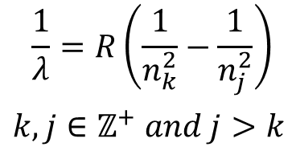
Spectral Emission Lines
Hydrogen Emission Lines
Rydberg Formula
$$\frac{1}{λ}=R\left(\frac{1}{n_{k}^{2}}−\frac{1}{n_{j}^{2}}\right)$$ $k,j∈ℤ^{+} and j>k$
$$Rydberg Constant \\ R=1.0967757×{10}^{7}m^{−1}$$
Initial orbit
Final orbit
$n_{j}=$ Initial orbit #
$n_{k}=$ Final orbit #

Slide 14
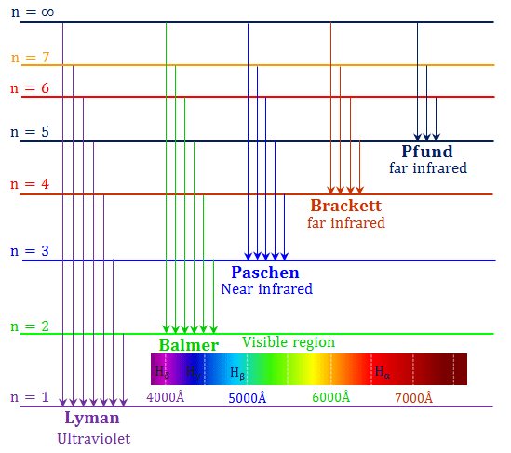
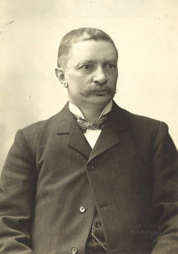
Spectral Emission Lines
Rydberg Formula
$$\frac{1}{λ}=R\left(\frac{1}{n_{k}^{2}}−\frac{1}{n_{j}^{2}}\right)$$ $k,j∈ℤ^{+} and j>k$
$$Rydberg Constant \\ R=1.0967757×{10}^{7}m^{−1}$$
Johannes Rydberg
(1865 – 1919)

Slide 15
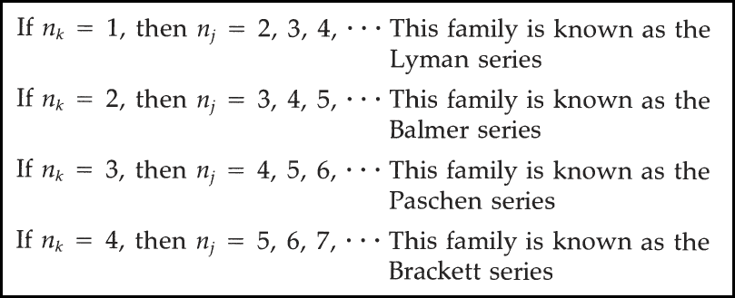
Rydberg Spectra for Hydrogen
https://en.wikipedia.org/wiki/Hydrogen_spectral_series
Update a Python console application to generate the anticipated wavelengths of the spectral emission of Hydrogen using the Rydberg formula
For each family from the Lyman to the Brackett series, display the first five (5) wavelengths (nm) in each series

Slide 16
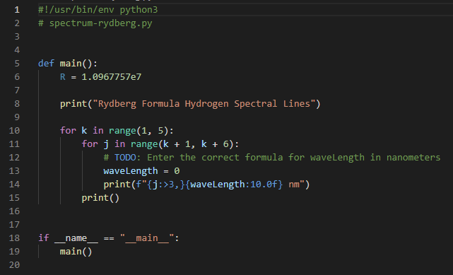

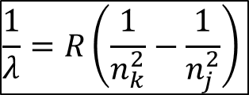
Edit spectrum_rydberg.py
$$\frac{1}{λ}=R\left(\frac{1}{n_{k}^{2}}−\frac{1}{n_{j}^{2}}\right)$$
Enter the correct formula

Slide 17
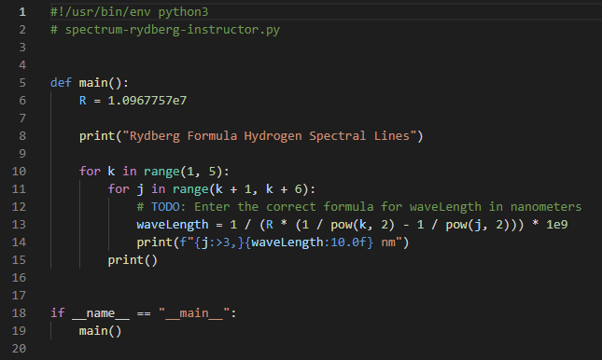
Edit spectrum_rydberg.py
$$\frac{1}{λ}=R\left(\frac{1}{n_{k}^{2}}−\frac{1}{n_{j}^{2}}\right)$$

Slide 18
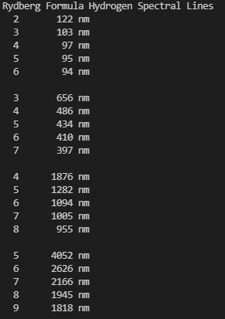
Run spectrum_rydberg.py
Lyman Series
Balmer Series
Paschen Series
Brackett Series

Slide 19

Formulas $≠$ Physics
Rydberg developed his formula in 1888 and it was later extended by Ritz to account for all known atoms
But it is still only an empirical formula – there was no explanation given as to why the formula worked
Fitting a curve mathematically and then making accurate predictions is still not physics if you don’t understand the underlying physical laws that lead to the equation
It took the next 50 years for science to understand the true nature of the formula and to realize the source of Rydberg’s constant

Slide 20

Physics Intuition: Voltage vs. Current
Potential Energy (Volts) From how high are the drops falling?
Current (Amps)
How many drops are falling per unit of time?
It is neither the size nor the speed of the drops

Slide 21
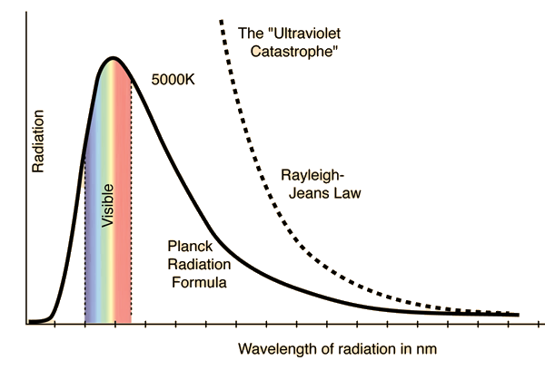
The Ultraviolet Catastrophe
Increasing energy
Classical theory could not explain the observed spectra

Slide 22
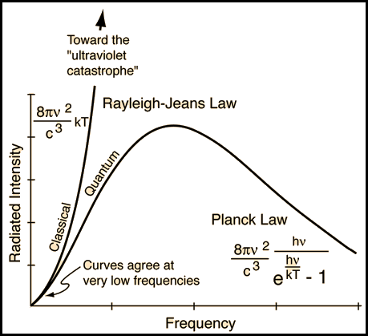
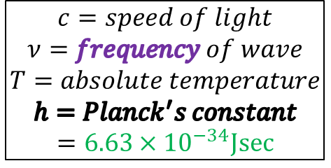
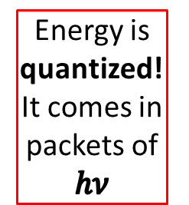
Max Planck’s Law - 1900
Increasing energy
$$c=speed of light \\ ν=frequency of wave \\ T=absolute temperature$$
$$h=Planck^{′}s constant \\ =6.63×{10}^{−34}Jsec$$
Energy is quantized!
It comes in packets of $hν$

Slide 23

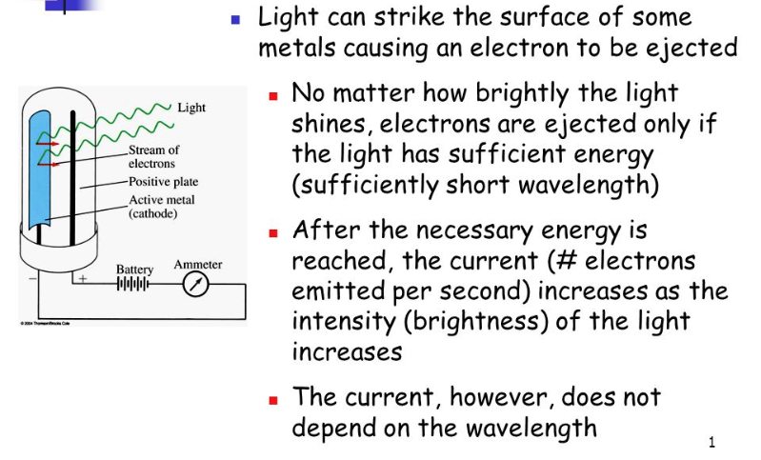

Einstein’s Photon Quantum - 1905

Slide 24
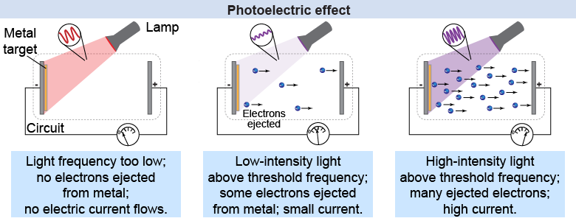
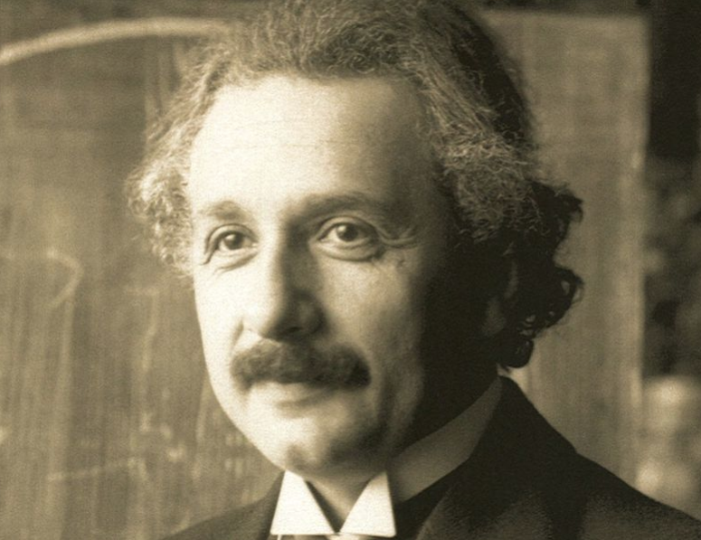
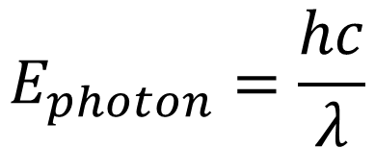
Einstein’s Photon Quantum - 1905
$$E_{photon}=\frac{hc}{λ}$$

Slide 25
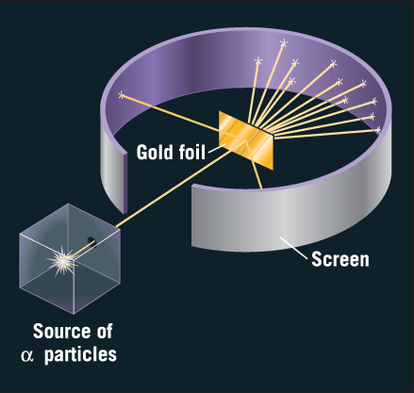
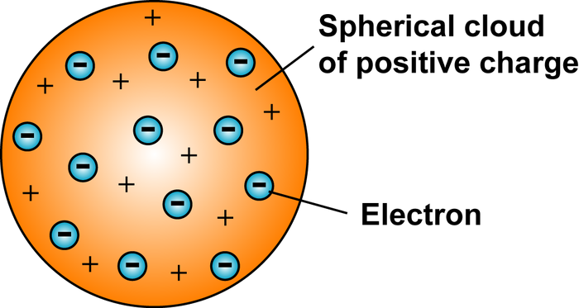
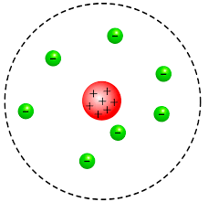
Early Atomic Models
J.J Thomson (1904)
E. Rutherford Experiment (1911)
But if like charges repel, then what keeps the protons close together?
Rutherford scattering indicated atoms have a heavy & compact nucleus

Slide 26
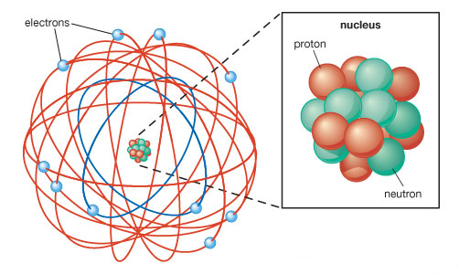
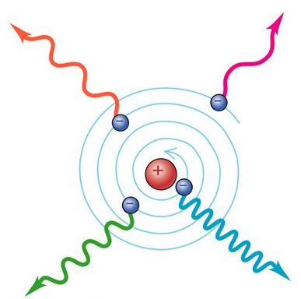
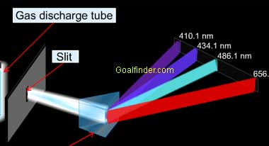
Early Atomic Models
The Rutherford model required even stable atoms to constantly emit radiation (but they don’t) and it could not explain discrete spectral emission lines

Slide 27
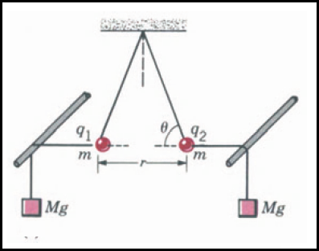
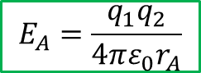
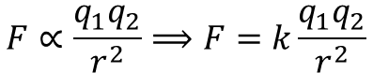
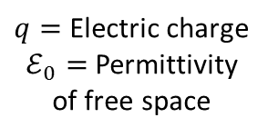
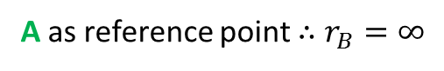
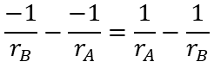
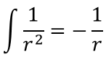

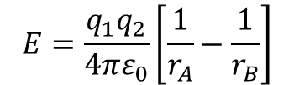
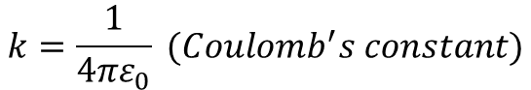



Electric Field Potential
$$Coulomb^{′}s Law$$
$$F∝\frac{q_{1}q_{2}}{r^{2}}⟹F=k\frac{q_{1}q_{2}}{r^{2}}$$
$$k=\frac{1}{4πε_{0}} (Coulomb^{′}s constant)$$
Eq 1
$$F=\frac{q_{1}q_{2}}{4πε_{0}r^{2}}$$
$q=$ Electric charge
$ℰ_{0}=$Permittivity of free space
Electric Field Potential
$$E=\frac{q_{1}q_{2}}{4πε_{0}}\left[\frac{1}{r_{A}}−\frac{1}{r_{B}}\right]$$
$$W_{A→B}=\int_{A}^{B}{Fⅆs}$$
q2
B
A
A as reference point $∴$ $r_{B}=∞$
$$E\left(r\right)=\frac{q_{1}q_{2}}{4πε_{0}}\int_{A}^{B}{\frac{1}{r^{2}}ⅆr}$$
q1
$$E_{A}=\frac{q_{1}q_{2}}{4πε_{0}r_{A}}$$
Eq 2
$$\int{\frac{1}{r^{2}}=−\frac{1}{r}}$$
$$\frac{−1}{r_{B}}−\frac{−1}{r_{A}}=\frac{1}{r_{A}}−\frac{1}{r_{B}}$$

Slide 28
















Atomic Model – N. Bohr - 1913
To stay
“in orbit”
Blue = Red
$$v=n\frac{ℏ}{mr}$$
Bohr: Angular momentum $L$is quantized and is a multiple $n$of Plank’s constant $ℏ$
$$L=mvr=nℏ$$
$$\frac{1}{4πε_{0}}\frac{e^{2}}{r^{2}}=\frac{m}{r}n^{2}\frac{ℏ^{2}}{m^{2}r^{2}}$$
$$r=n^{2}\frac{4πε_{0}ℏ^{2}}{e^{2}m}$$
$$ℏ=\frac{h}{2π}$$
Eq 4
$$F=\frac{q_{1}q_{2}}{4πε_{0}r^{2}}$$
Eq 1
$$r=\frac{(1.11×\frac{{10}^{−10}C^{2}}{Nm^{2}}){(1.05×{10}^{−34}Jsec)}^{2}}{{\left(1.6×{10}^{−19}C\right)}^{2}(9.1×{10}^{−31}kg)}$$
$$n=1$$
$$q_{electron}=−e \\ q_{proton}=+e$$
$$r=0.53×{10}^{−10}=0.53 Å$$
$$F_{radial}=m{∗a}_{radial}$$
$$\frac{1}{4πε_{0}}\frac{e^{2}}{r^{2}}=m\frac{v^{2}}{r}$$
Eq 3

Slide 29













Atomic Model – N. Bohr - 1913
Eq 2
$$E=\frac{q_{1}q_{2}}{4πε_{0}r}$$
$$E_{TOTAL}=kinetic +potential$$
$$E_{TOTAL}=\frac{1}{2}mv^{2}−\frac{1}{4πε_{0}}\frac{e^{2}}{r}$$
Potential is negative because
$$q_{1}=−e \& q_{2}=e$$
$$E_{TOTAL}=\frac{1}{2}\left[\frac{1}{4πε_{0}}\frac{e^{2}}{r}\right]−\left[\frac{1}{4πε_{0}}\frac{e^{2}}{r}\right]$$
Eq 3
$$\frac{1}{4πε_{0}}\frac{e^{2}}{r^{2}}=m\frac{v^{2}}{r}$$
$$E_{TOTAL}=−\frac{1}{2}\left[\frac{1}{4πε_{0}}\frac{e^{2}}{r}\right]$$
$$\frac{r}{2}\left[\frac{1}{4πε_{0}}\frac{e^{2}}{r^{2}}\right]=\frac{r}{2}\left[m\frac{v^{2}}{r}\right]$$
$$r=n^{2}\frac{4πε_{0}ℏ^{2}}{e^{2}m}$$
$$h=2πℏ$$
Eq 4
$$\frac{1}{2}mv^{2}=\frac{1}{2}\left[\frac{1}{4πε_{0}}\frac{e^{2}}{r}\right]$$
$$E_{n}=−\frac{e^{4}m}{8ε_{0}^{2}h^{2}}\frac{1}{n^{2}}$$
$$n=orbit \#$$
Eq 5

Slide 30








Atomic Model – N. Bohr - 1913
$$E_{n}=−\frac{e^{4}m}{8ε_{0}^{2}h^{2}}\frac{1}{n^{2}}$$
Eq 5
$$E_{0}=\frac{e^{4}m}{8ε_{0}^{2}h^{2}}$$
$E_{0}=$Just the constants
$$E_{n}=−\frac{E_{0}}{n^{2}},n=1,2,3,…$$
$$n=orbit \#$$
$$E_{final}−E_{initial}=\frac{hc}{λ}$$
Einstein’s Photon Energy Quantum
When an electron falls back to its ground state, it will emit a photon at the wavelength associated with the corresponding energy delta
$$λ=\frac{hc}{E_{final}−E_{initial}}$$

Slide 31







Open Lab 2 – Bohr Spectra for Hydrogen
Update a Python console application to display the predicted wavelengths for the spectral emission of the Hydrogen atom using Bohr’s Atomic model
$$e=1.6×{10}^{−19}C \\ m=9.1×{10}^{−31}kg \\ ε_{0}=8.84×{10}^{−12}C^{2}/Nm^{2} \\ h=6.63×{10}^{−34}Jsec \\ c=3×{10}^{8}m/sec$$
$$E_{0}=\frac{e^{4}m}{8ε_{0}^{2}h^{2}}$$
$$E_{n}=−\frac{E_{0}}{n^{2}}, n=1,2,3,…$$
$$n=orbit \#$$
Note: The SI unit for distance is meters (m) but we want the results shown in nanometers (nm)
$$λ=\frac{hc}{E_{final}−E_{initial}}$$
$$E_{i}=E_{initial}$$
$$E_{f}=E_{final}$$

Slide 32

Edit spectrum_bohr.py

Slide 33

Edit spectrum_bohr.py

Slide 34

Run spectrum_bohr.py
Lyman Series
Balmer Series
Paschen Series
Brackett Series

Slide 35










Atomic Model – N. Bohr - 1913
$$E_{n}=−\frac{e^{4}m}{8ε_{0}^{2}h^{2}}\frac{1}{n^{2}}$$
Eq 5
$$E_{initial}−E_{final}=\frac{hc}{λ}$$
$$E_{n}=−\frac{E_{0}}{n^{2}},n=1,2,3,…$$
$$\left(−\frac{E_{0}}{n_{i}^{2}}\right)−\left(−\frac{E_{0}}{n_{f}^{2}}\right)=\frac{hc}{λ}$$
$$E_{0}=\frac{e^{4}m}{8ε_{0}^{2}h^{2}}$$
$i,f∈ℤ^{+} and f>i$
$$\frac{1}{λ}=\frac{E_{0}}{hc}\left(\frac{1}{n_{f}^{2}}−\frac{1}{n_{i}^{2}}\right)$$
Rydberg Formula
$$\frac{1}{λ}=R\left(\frac{1}{n_{k}^{2}}−\frac{1}{n_{j}^{2}}\right)$$
$$R_{Bohr}=\frac{E_{0}}{hc}=\frac{e^{4}m}{8ε_{0}^{2}h^{3}c}$$
$$Rydberg Constant \\ R=1.0967757×{10}^{7}m^{−1}$$
$$R_{Bohr}=1.09740×{10}^{7}m^{−1}$$

Slide 36




Atomic Model – N. Bohr - 1913
Rydberg Formula
Bohr Formula
$$\frac{1}{λ}=R\left(\frac{1}{n_{k}^{2}}−\frac{1}{n_{j}^{2}}\right)$$ $where k,j∈ℤ^{+} and j>k$
$$\frac{1}{λ}=R_{Bohr}\left(\frac{1}{n_{f}^{2}}−\frac{1}{n_{i}^{2}}\right)$$ $where f,i∈ℤ^{+} and f>i$
$$Rydberg Constant \\ R=1.0967757×{10}^{7}m^{−1}$$
$$Bohr Constant \\ R_{Bohr}=1.09740×{10}^{7}m^{−1}$$
Now we are doing physics!
With Bohr’s model we can assemble a logical sequence of physical laws to derive an empirical rule!

Slide 37


Atomic Model – N. Bohr - 1913

Slide 38
Atomic Model – N. Bohr - 1913
Rydberg Formula
Bohr Model
The Bohr Model still had problems!

Slide 39

Bohr Didn’t Include Electron “Spin”

Slide 40

Bohr Didn’t Include Electron “Spin”
1924

Slide 41
Now you know…
Double-slit diffraction enables measurement of wavelengths
The Rydberg Formula indicated an underlying model existed, but an equation without an explanation is just a nifty observation
Consider the plight of early atomic models – how do you measure something you cannot possibly see?
At the atomic level, Mother Nature is quantized – this violates common experience with continuous spectrums
Don’t be scared off by a soup of complex looking symbols and a long series of equations – learn to glide with them!

